Slide 1
SQL Server 2000 Internals
Architecture Components
Ramkumar Murugesan

Slide 2
Architecture Components
SQL Server Architecture
Net Library and ODS
User Mode Scheduler
Relational Engine Components
Storage Engine Components
Other Components

Slide 3
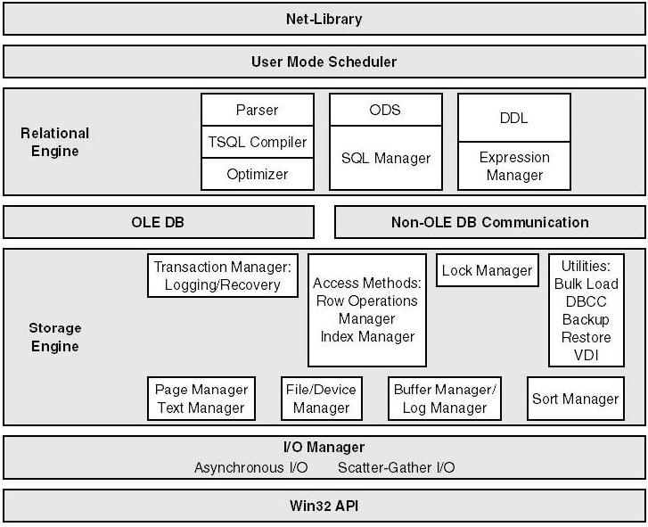
SQL Server Architecture

Slide 4
Next Section>>>
Net Library
Topics…
Net Libraries Types | Communication Methods | Behind the scenes | Architecture | Super Socket Components

Slide 5
Net Library
DLLs that enable SQL Server to read from and write to many different network protocols
SQL Server uses the Net-Library on both the server and client machines
Net-Libraries are paired
The client application determines which Net-Library is used for communication
Client Network Utility: Controls Client application's choice
Server Network Utility: Configures SQL Server to listen to multiple Net-Libraries

Slide 6
Net Library
Two Primary Net-Libraries - Super Socket and Shared Memory
Two methods of communication between Applications and DB Server
  When the application and SQL Server are on same computer, Windows IPC (Shared Memory) is used
  When the application is on a separate server, a network IPC (Super Socket) is used
The OLE DB Provider for SQL Server, SQL Server ODBC driver, and the database engine communicate directly with primary Net-Libraries
Secondary Net-Libraries - TCP/IP, Named Pipes, IPX/SPX

Slide 7
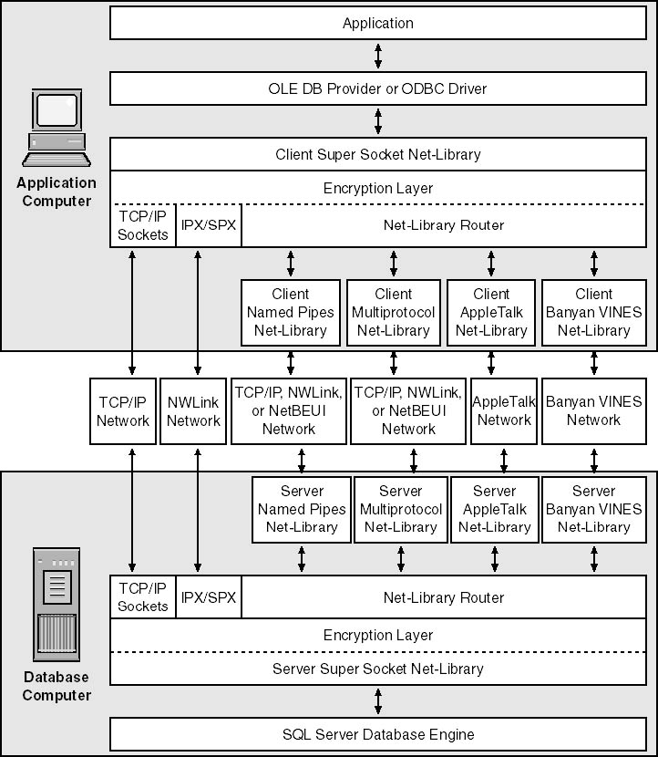
Net Library

Slide 8
Net Library - Super Socket Components
The Super Socket Net-Library has two components
  Communication path
  Encryption Layer
Communication path - If client is configured to communicate over a…
  TCP/IP Socket or NWLink IPX/SPX connection - the Super Socket Net-Library calls the Windows Socket for the communication between the application and the SQL Server instance
  Named Pipes, Multiprotocol, AppleTalk, or Banyan VINES connection - a subcomponent of the Super Socket Net-Library called the Net-Library router loads the secondary Net-Library for the chosen protocol and routes all Net-Library calls to it

Slide 9
Net Library - Super Socket Components
Encryption layer
  Encryption is implemented using Secure Sockets Layer (SSL) API
  The level of encryption, 40-bit or 128-bit, depends on the Windows version on the application and SQL Server-based computers
  Enabling encryption can slow network performance
  Shared Memory Net-Library communication is secure without the need for encryption
  The area of memory shared between the application process and the database engine process cannot be accessed from any other Windows process

Slide 10
Open Data Services (ODS)
An interface between server Net-Libraries and SQL Server
ODS manages the network and functions as the client manager for SQL Server
Common activities…
  Listens for new connections
  Acknowledges "attentions" (cancellations of commands)
  Returns result sets, messages, and status values back to client
  If a client unexpectedly disconnects, ODS automatically frees resources such as locks held by that client
SQL Server client and server speak through Tabular Data Stream

Slide 11
User Mode Scheduler
A scheduler program that acts as a layer between the physical server and the operating system for scheduling SQL related tasks
UMS is designed to keep the SQL Server related threads in user mode
Avoids context switching and reduces the intervention of kernel
Works in cooperative tasking mode and not in pre-emptive mode
How it works…
  Each thread under UMS has an associated event object
  While scheduling, Windows ignores threads in infinite wait state
  Knowing this, UMS puts threads to sleep that it does not want to be scheduled by having them call WaitForSingleObject on their corresponding event object and passing INFINITE as timeout value

Slide 12
Next Section>>>
Relational Engine Components
Topics…
Command Parser | Optimizer | SQL Manager | Expression Manager | Query Executor

Slide 13
The Command Parser
The command parser –
  Checks for proper syntax
  Translates T-SQL commands into an internal format
  This internal format is known as a query tree or sequence tree
If the parser doesn't recognize the syntax, a syntax error is raised
Only the command parser can access the source of the statement
The statement is no longer available in source format when the command is actually executed
For this reason non-syntax error messages cannot be explicit about the exact source line that caused the error

Slide 14
The Optimizer
Optimizer –
  Takes the query tree from command parser
  Compiles an entire command batch
  Checks security
  chooses the best execution plan and Optimizes queries
Some of the Internal metrics that optimizer evaluates are…
  Memory requirements, CPU utilization and Required I/O
  Amount of data in the various tables affected
  Indexes available for each table
  Data Samples kept for each index/column referenced in the query

Slide 15
The SQL Manager
Manages stored procedures and their plans
Manages the caching of procedure plans so that other processes can reuse them
Determines when a stored procedure needs recompilation based on changes in the underlying objects' schemas
Handles autoparameterization of ad-hoc queries

Slide 16
Next Section>>>
Storage Engine Components
Topics…
Access Method Manager | Page/Text Manager | Transaction Manager | Lock Manager | Other Managers

Slide 17
Access Method Manager
When SQL Server needs to locate data, it calls the access methods manager
The access methods manager
  Retrieves data and index pages by placing a request to buffer manager
  Prepares the OLE DB row sets to return to the relational engine
Access methods manager has two components
  Row operations manager (ROM)
  Index Manager

Slide 18
Access Method Manager
ROM retrieves and modifies individual rows in database
After formatting or modifying a row in memory, the ROM inserts or deletes a row in the database
SQL Server ROM uses three update modes
  In-Place Mode – to update heap/clustered Index when no clustering keys change
  Split Mode – to update non-unique indexes when the index keys change
  Split with Collapse Mode - to update unique indexes when index keys change
The Index Manager maintains and supports searches on B-trees
B-Trees are the storage structure for SQL Server indexes

Slide 19
Page and Text Manager
The page manager and the text manager cooperate to manage a collection of pages
The page manager allocates and de-allocates all types of disk pages, organizing extents of eight pages each
If an object uses fewer than eight pages (<64 KB), the page manager allocates new pages from mixed extents
This process prevents too much wastage of free space
When the size of the object exceeds eight pages, the page manager allocates an entire uniform extents
Contiguous data helps in faster retrieval of data

Slide 20
Other Managers
Transaction Managers
  Handles transactions that cross databases within the same SQL Server
  Marks ‘savepoints’ and let you designate points within a transaction at which work can be partially rolled back or undone
Lock Managers
  Acquires and Releases various types of locks
  Manages compatibility between the lock types
  Resolves deadlocks and Escalates locks (if needed)
There are managers for controlling utilities such as bulk load, DBCC commands, backup/restore operations, control sorting operations etc

Slide 21
Other Components
The Expression Manager
  Handles computation, comparison, and data movement in queries
  For eg in the below mentioned query, SELECT @myqty = qty * 10 FROM mytable
  the expression manager is responsible for copying the value of qty from the row set returned by the storage engine, multiplies it by 10, and stores the result in @myqty
The Query Executor
  Runs the execution plan that the optimizer produced, acting as a dispatcher for all the commands in the execution plan

Slide 22
End of Topic – Architecture Components
?

Slide 23
End of Topic – Architecture Components
Thank you
Next Topic
Architecture Components | Storage Concepts | Transaction Logs | Indexes I | Indexes II | Locking I | Locking II | Query Processor

